Slide 1
SW 332
EVENTURE
EVENT MANAGEMENT SYSTEM
Prepared for :
Ms. Daniah Alshobaili

Slide 2
Student Name | ID
Rana zaid Al askar | 445009176
Rand Abdullah Alzoman | 445009181
Lujain Eid Alruwaili | 4450009180
Jumanah Maher Aljuhani | 445009184
Munirah Almousa | 445009156

Slide 3

Introduction
Sprint 1 focused on building the core features of the Eventure system. The team implemented user registration, event creation and management, ticket handling, and QR-based check-in. These functions form the system’s foundation, enabling organizers to manage events efficiently and attendees to register and check in easily.

Slide 4

Scrum Team
Responsibilities | Member | Role
Define the vision and prioritize backlog items | Jumanah | Product Owner
Organize meetings and remove obstacles | Lujain | Scrum Master
Develop front-end, back-end, database, and testing | Rand Munirah Rana | Development Team

Slide 5
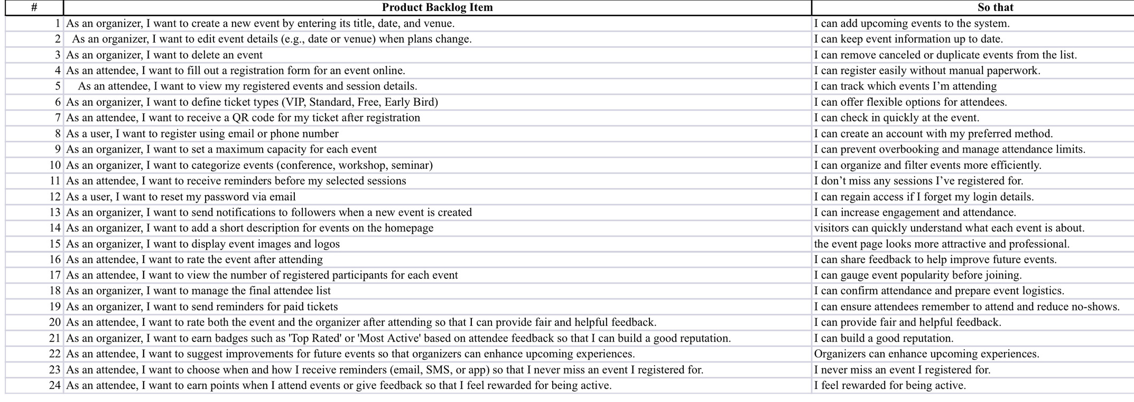
Product backlog

Slide 6

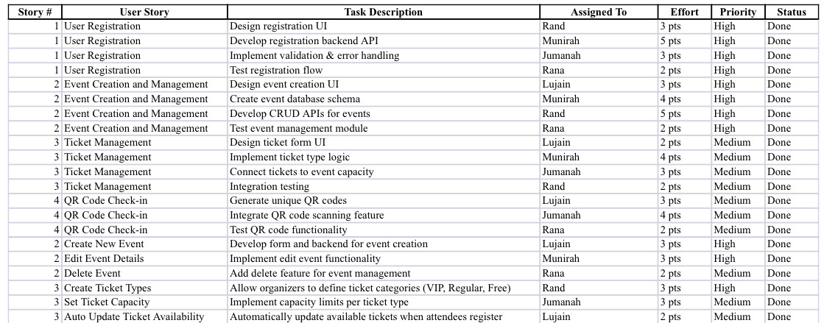
Sprint Backlog

Slide 7

1. Sprint Goal
Deliver the core functionalities of the Eventure system by implementing event creation, user registration, ticket management, and QR-based check-in.

Slide 8
Selected Product Backlog Items (with Acceptance Criteria)
• • Title: User Registration
Description: As a user, I want to register using my email or phone number so that I can access the system.
Acceptance Criteria:
- Users can sign up using email or phone.
- Validation ensures unique email/phone per account.
- Successful registration redirects users to the dashboard.
• • Title: Event Creation and Management
Description: As an organizer, I want to create, edit, and delete events so that I can manage upcoming events easily.
Acceptance Criteria:
- Organizers can add new events with all details (name, date, location, capacity).
- Organizers can edit or delete their events.
- System validates that required fields are filled before

Slide 9
Selected Product Backlog Items (with Acceptance Criteria)
• • Title: Ticket Management
Description: As an organizer, I want to define ticket types and capacities so that attendees can choose suitable tickets.
Acceptance Criteria:
- Organizers can create multiple ticket types (VIP, Regular, Free).
- Ticket limits are enforced according to event capacity.
- System updates available tickets dynamically when attendees register.
• • Title: QR Code Check-in
Description: As an attendee, I want to receive a QR code for my ticket so that I can check in quickly at the event.
Acceptance Criteria:
- System generates a unique QR code for each registration.
- The QR code contains ticket ID and user info.
- Event staff can scan the QR code to mark attendance.

Slide 10
Refine Sizing (Applying INVEST)
User Story 2 – Original (L)
Original:
As an organizer, I want to create, edit, and delete events so that I can manage upcoming events easily.
(Size: L)
Revised (split into smaller stories):
• (S) As an organizer, I want to create a new event so that I can add it to the system.
• (S) As an organizer, I want to edit existing event details so that I can update event information.
• (S) As an organizer, I want to delete an event so that I can remove canceled or outdated events.

Slide 11
Refine Sizing (Applying INVEST)
User Story 3 – Original (L)
Original:
As an organizer, I want to define ticket types and capacities so that attendees can choose suitable tickets.
(Size: L)
Revised (split into smaller stories):
• (S) As an organizer, I want to create multiple ticket types (VIP, Regular, Free) so that I can offer flexible options.
• (S) As an organizer, I want to set ticket capacity limits so that event attendance stays within venue capacity.
• (S) As an organizer, I want the system to automatically update available tickets when registrations occur.

Slide 12
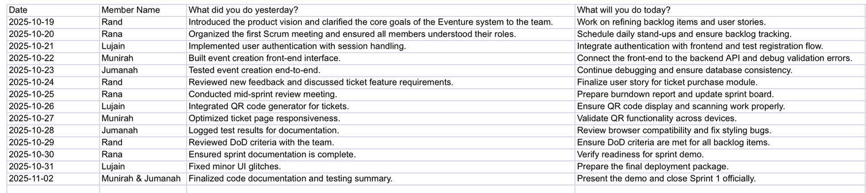
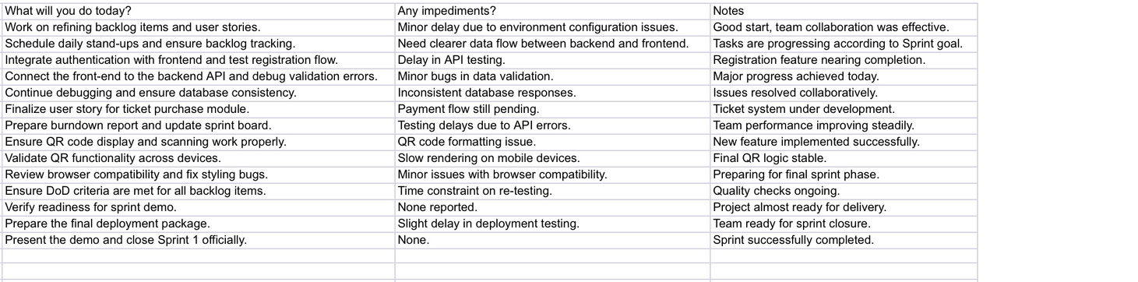
Daily scrum meeting

Slide 13
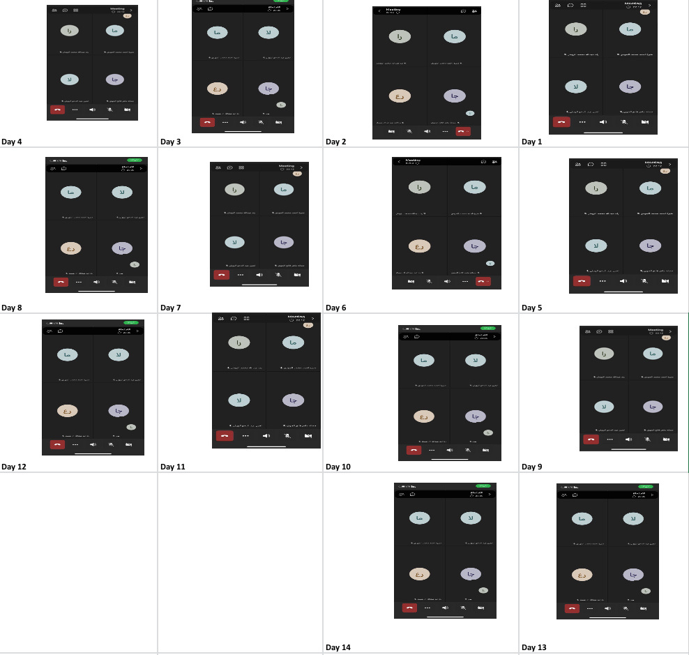
Daily scrum meeting

Slide 14
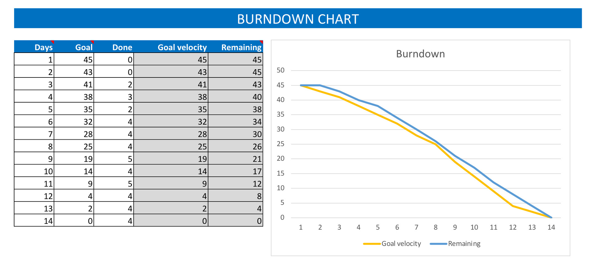
BurnDown Chart

Slide 15
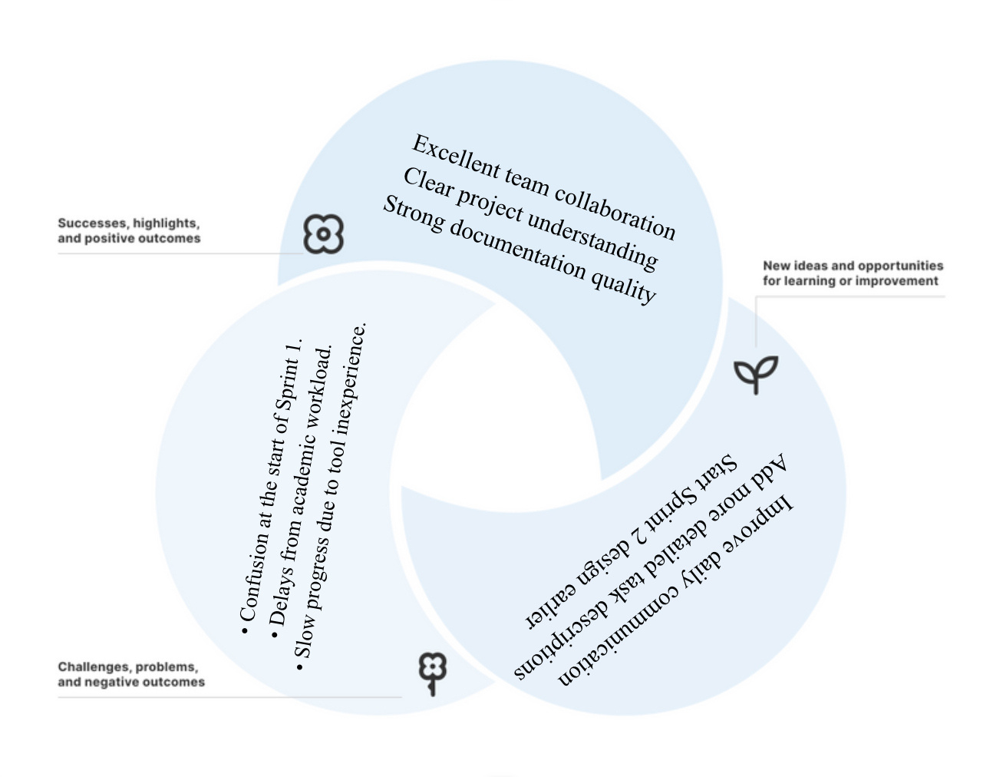
Sprint Retrospective

Slide 16
Definition of Done (DoD)
• Code is reviewed and passes all unit tests.
• All acceptance criteria are met and verified by Product Owner.
• Documentation and user guides updated.
• Feature deployed successfully to test environment.
• No critical bugs remain unresolved

Slide 17
Summary
Sprint 1 was successful in meeting its objectives and delivering a functional version of the Eventure system. The team demonstrated strong collaboration, adherence to Scrum principles, and effective communication throughout the sprint. The foundation is now set for Sprint 2 to build upon this success and expand the platform’s capabilities.

Slide 18
THANK YOU
FOR ATTENTION

